Slide 1

Seasonal Performance Study of Indian Farms
Surab Ghosh
Chandigarh University
AICTE STU ID :STU6a6b11df67ddd1785401823

Slide 2

PROBLEM STATEMENT
Agricultural activities are influenced by seasonal variations in environmental conditions, farming practices, resource availability and market conditions. As a result, agricultural performance may differ from one season to another.
However, raw agricultural data does not clearly explain how agricultural performance changes across seasons or what patterns can be observed in different seasonal conditions.
The problem is to analyse the given agricultural dataset and investigate seasonal differences in agricultural performance by identifying meaningful patterns, trends, relationships and variations within the available data.

Slide 3
Project Description
An independent data-analytics investigation of the Seasonal Agriculture Performance dataset (4,000 records; 8 states, 8 crops, 3 seasons), built around four guiding questions rather than a generic column-by-column scan.
Covers data cleaning, univariate/bivariate/multivariate analysis and three original follow-up investigations - state-level consistency, farm-size effects, and crop-by-season disease risk - concluding in evidence-based findings and recommendations.

Slide 4

WHO ARE THE END USERS?
Farmers and farmer groups planning crop and irrigation choices by season
State agriculture departments and extension officers
Agri-fintech and crop-insurance providers assessing seasonal risk
Agricultural researchers and students studying seasonal patterns
Policy planners designing state- and season-specific advisories

Slide 5

Technology Used
Python 3 (Google Colab / Jupyter Notebook)
Pandas & NumPy - data cleaning and analysis
Matplotlib & Seaborn - data visualization
Dataset: 4,000 seasonal farm records (CSV)

Slide 6
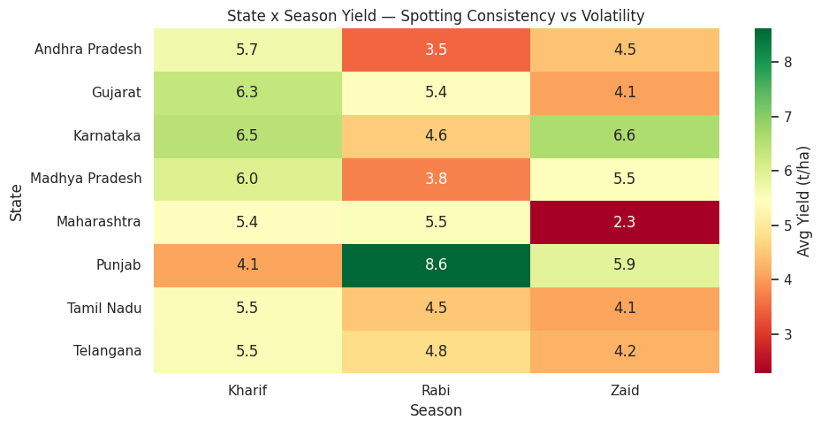
RESULTS
State x season yield heatmap: Tamil Nadu ranks consistently mid-table every season; Punjab swings from #1 (Rabi) to last (Kharif).

Slide 7
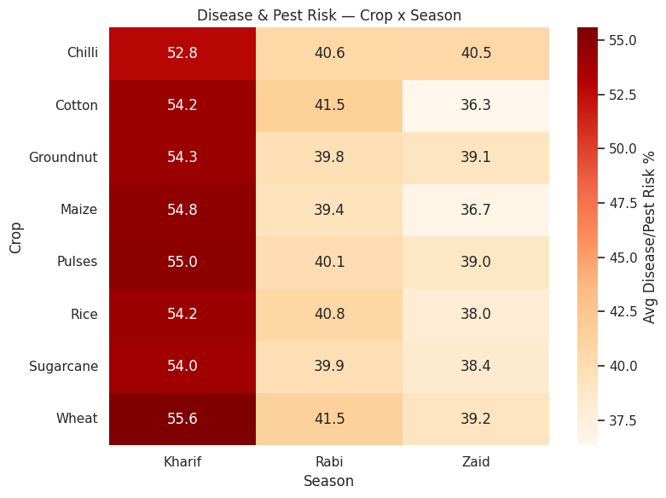
RESULTS
Disease/pest risk by crop and season: risk concentrates heavily in Kharif, peaking with Wheat (~55.6%).

Slide 8
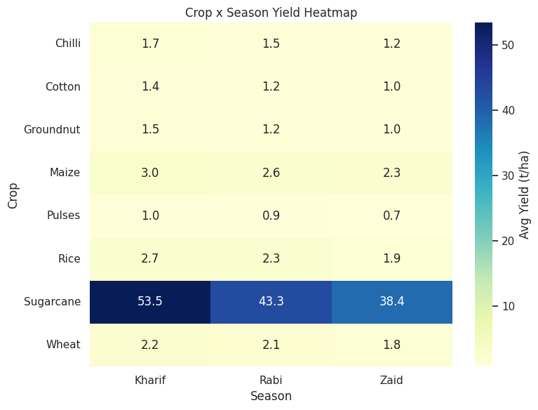
RESULTS
Crop x season yield heatmap: Sugarcane sits on a completely different scale (38-53 t/ha) than every other crop.

Slide 9
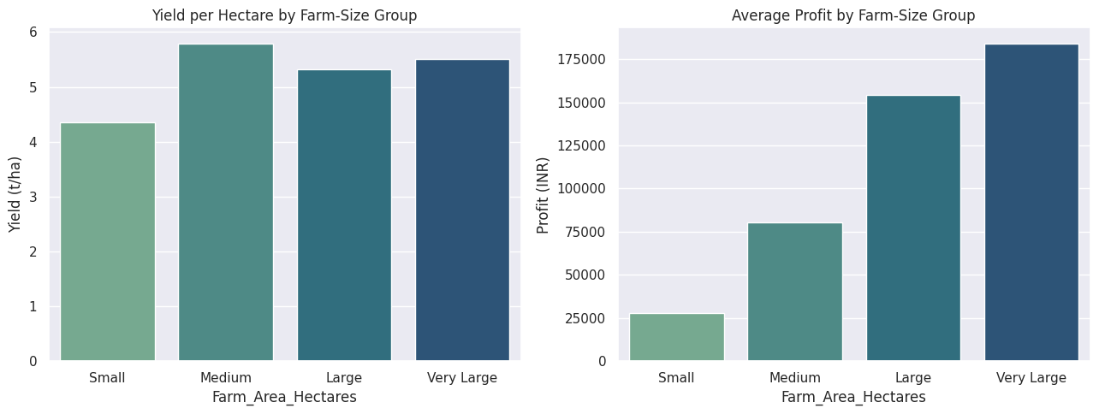
RESULTS
Farm-size groups: average profit rises sharply with farm size, but yield per hectare stays roughly flat - profit scales mainly through land area.

Slide 10
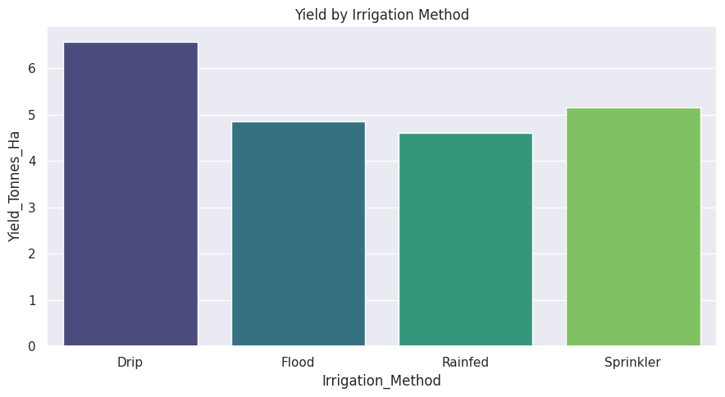
RESULTS
Drip irrigation delivers the highest average yield among the four irrigation methods studied.

Slide 11
Future scope
Extend to a multi-year dataset to test whether these seasonal patterns are stable trends or specific to a single snapshot in time.
Investigate why Zaid underperforms in more depth - water access, heat stress and cost structure could each be tested separately.
Study why Punjab and Tamil Nadu diverge so sharply in seasonal behaviour, to build genuinely state-specific advisories.
Pilot a controlled comparison of irrigation methods within the same crop and state to isolate irrigation's real effect on yield.
Turn the crop x season risk heatmap into a live monitoring dashboard for extension officers ahead of high-risk periods.

Slide 12
GitHub Link
Repository: https://github.com/surab7/seasonal-agriculture-performance-study.git

Slide 13

VOIS Course completion certificate - Course name- Data Visualization

Slide 14
Thank you
.
.

